Slide 1
Permissioned Distributed Ledgers Smart Contracts and IoT
Tooba Faisal
King’s College London
ICT Verticals and Horizontals for Blockchain Standardisation
27.01.2021

Slide 2
Agenda
Introduction to ETSI ISG PDL(Permissioned Distributed Ledgers)
Smart contracts: An introduction
Smart contracts and IoTs
Smart contract standardisation ISG PDL
Notes:
We start with introduction of our group what we are doing in ETSI PDL. And then move on introduction to smart contracts, Smart contracts and IoT and then smart contract standardization at ISG PDL

Slide 3
ISG - PDL

Slide 4
The ISG PDL Goals and Scope
Provide the foundations for the operation of permissioned distributed ledgers
Create an open ecosystem of industrial solutions
Deployable by different sectors
Foster the application of the technology
Start from already available experiences
Coordinate with existing initiatives
Define a set of well-known open operational mechanisms
Support their demonstration
Facilitate interoperability assessment
More than thirty members from industry (telco and not telco), public sector and academia
Notes:
This goal of this is ISG is to provide the foundations for the operations of permissioned distributed ledgers - in which create an open eco system of industrial solutions which is deployable by different sectors.
2) And to foster the application of the technology and define a set of well-known open operational mechanisms.

Slide 5
The Work Programme (I)
PDL-001 - Landscape of Standards and Technologies
Identify relevant activities in standardization and research.
PDL-002 - Applicability and Compliance to Data Processing Requirements
Analyse the essential data processing requirements
PDL-003 – Application Scenarios
Potential application scenarios for the operation of PDLs and governance aspects
PDL-004 – Smart Contracts PDL System Architecture and Functional Specification
Planning, designing and programming frameworks
PDL-005 – PoC Framework
Build commercial awareness and confidence and encourage development of an open ecosystem
Notes:
In our work program we have 10 work items, out of 3 are already published and one is close to publication. So we have 6 are ongoing WIs in which PoC framework

Slide 6
The Work Programme (II)
PDL-006 – Inter-Ledger Interoperability
Key elements for the exchange and use of the information available across DLs
PDL-007 – Research Landscape
Facilitate exchange of information on PDL related research projects
PDL-008 – PDL Research and Innovation Landscape
Document research and innovation projects relevant for BDLT standardisation
PDL-009 – PDL for federated Data Management
Architecture and key functional mechanisms leveraging PDL for federated data management
PDL-010 – PDL Operations in Offline Mode
Challenges related to data storage and ledger operations when the PDL nodes are offline
Notes:
Inter-ledger interoperability
Research landscape
Pdl research and innovation landscape
Federated data management
PDL operations in offline mode

Slide 7
Smart contracts
Notes:
So lets move on to smart contract - a brief introduction of smart contracts

Slide 8
Smart Contracts: An Introduction
Software codes installed on Permissioned Distributed Ledgers (PDLs)
PDLs : Distributed Immutable data structures where all the participants keep a copy of the ledger
Properties
Immutable
Once recorded cannot be changed or amended
Auto-executable
Triggered by software condition
Transparent
Because they are installed on PDLs – all the participants of the ledger keep the same copy
Notes:
Smart contracts are software code, they are installed on permissioned distributed ledgers, PDLs or permissioned distributed ledgers are immutable data structure in which node keeps a copy of the same ledger. Because smart contracts are installed on the PDL, they inherit the properties of the PDLs. 1) Immutability – this means when the contract is installed it cannot be changed or amended 2) auto-executable – means they can be trigged by a software condition without any human intervention and 3) they are transparent means that every participant of the ledger keep a copy of the ledger.

Slide 9
Smart contracts and IoT
Notes:
Lets discuss why smart contract are important for future IoT

Slide 10

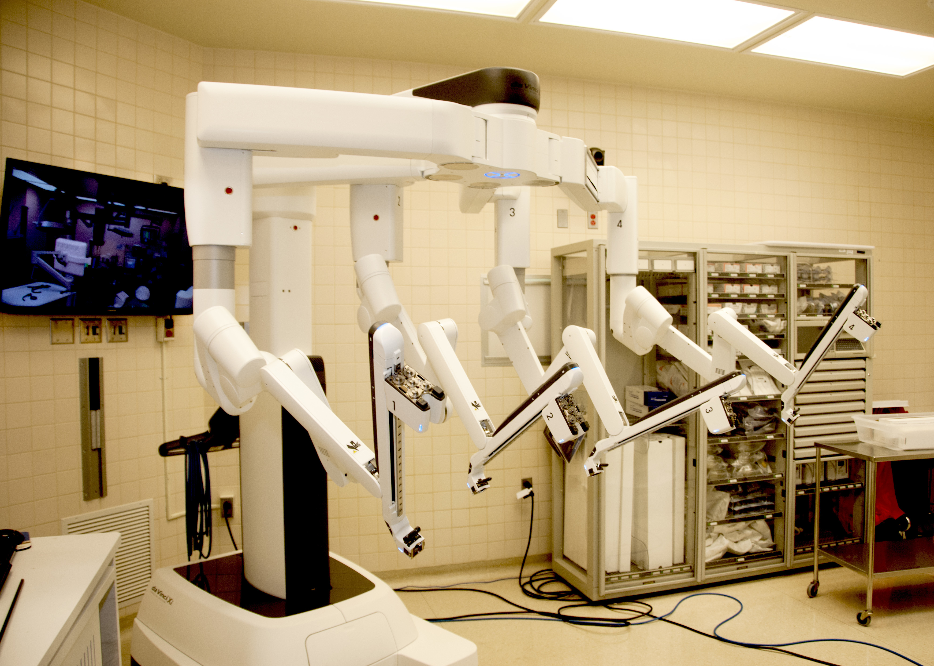
Key Requirements for the future IoTs
Service Availability (ex: Connected car)
Service Reliability (ex: Remote surgery)
Not all IoTs need super-fast connection (ex: electricity meters)
Service Level Agreement (SLA) guarantee
Accountability
Flexibility of service contract
This Photo by Unknown Author is licensed under CC BY-SA
Notes:
millions of IoTs are already deployed in the world and we see huge diversity in the applications of IoTs. But to adopt IoTs for life relying applications certain requirements are important
1) An operator of an autonomous vehicle would like service availablity from the source to the destination. Because if there is service drop on the way, the vehicle cannot get the navigation data and may be lost.
2) A surgeon who might be sitting miles a part conducting a remote surgery would ensure that all the health sensors used during the surgery provide timely data.
3) But not all services need low-latency connection such as electricity meters - and the customers may choose to get service contract with not super-fast and super-relible network quality.
So we can say that for IoT application the key requirements are SLA guarantee, if an operator commits for a service contract, it should be honored, 2) accountability – when an SLA is agreed then any violation to this SLA should be accountable - the contractual system should be pinpoint exactly why the violation happened and which party was responsible for this and 3rd is the flexibility of the contract, this means the customer should be able to network service as per their requirements and for certain duration only.

Slide 11
How smart contracts can facilitate IoTs’ SLAs?
Trustworthy service agreement record-keeping
Transparency
Automated payments and settlement of SLA infringements
Self-execution
No service agreement tampering possible
Immutability
Notes:
If SLAs are programmed as smart contract. This way smart contracts' inherent properties enable accountable and automated SLAs.
because smart contracts are transparent - which means that all the parties of ledger keep a copy of the contract the enable trustworthy service agreement and record-keeping
smart contracts - once they are installed they are self-executable means automated payment for penalities
and immutability because smart contracts are immutable no service agreement tampering is possible

Slide 12
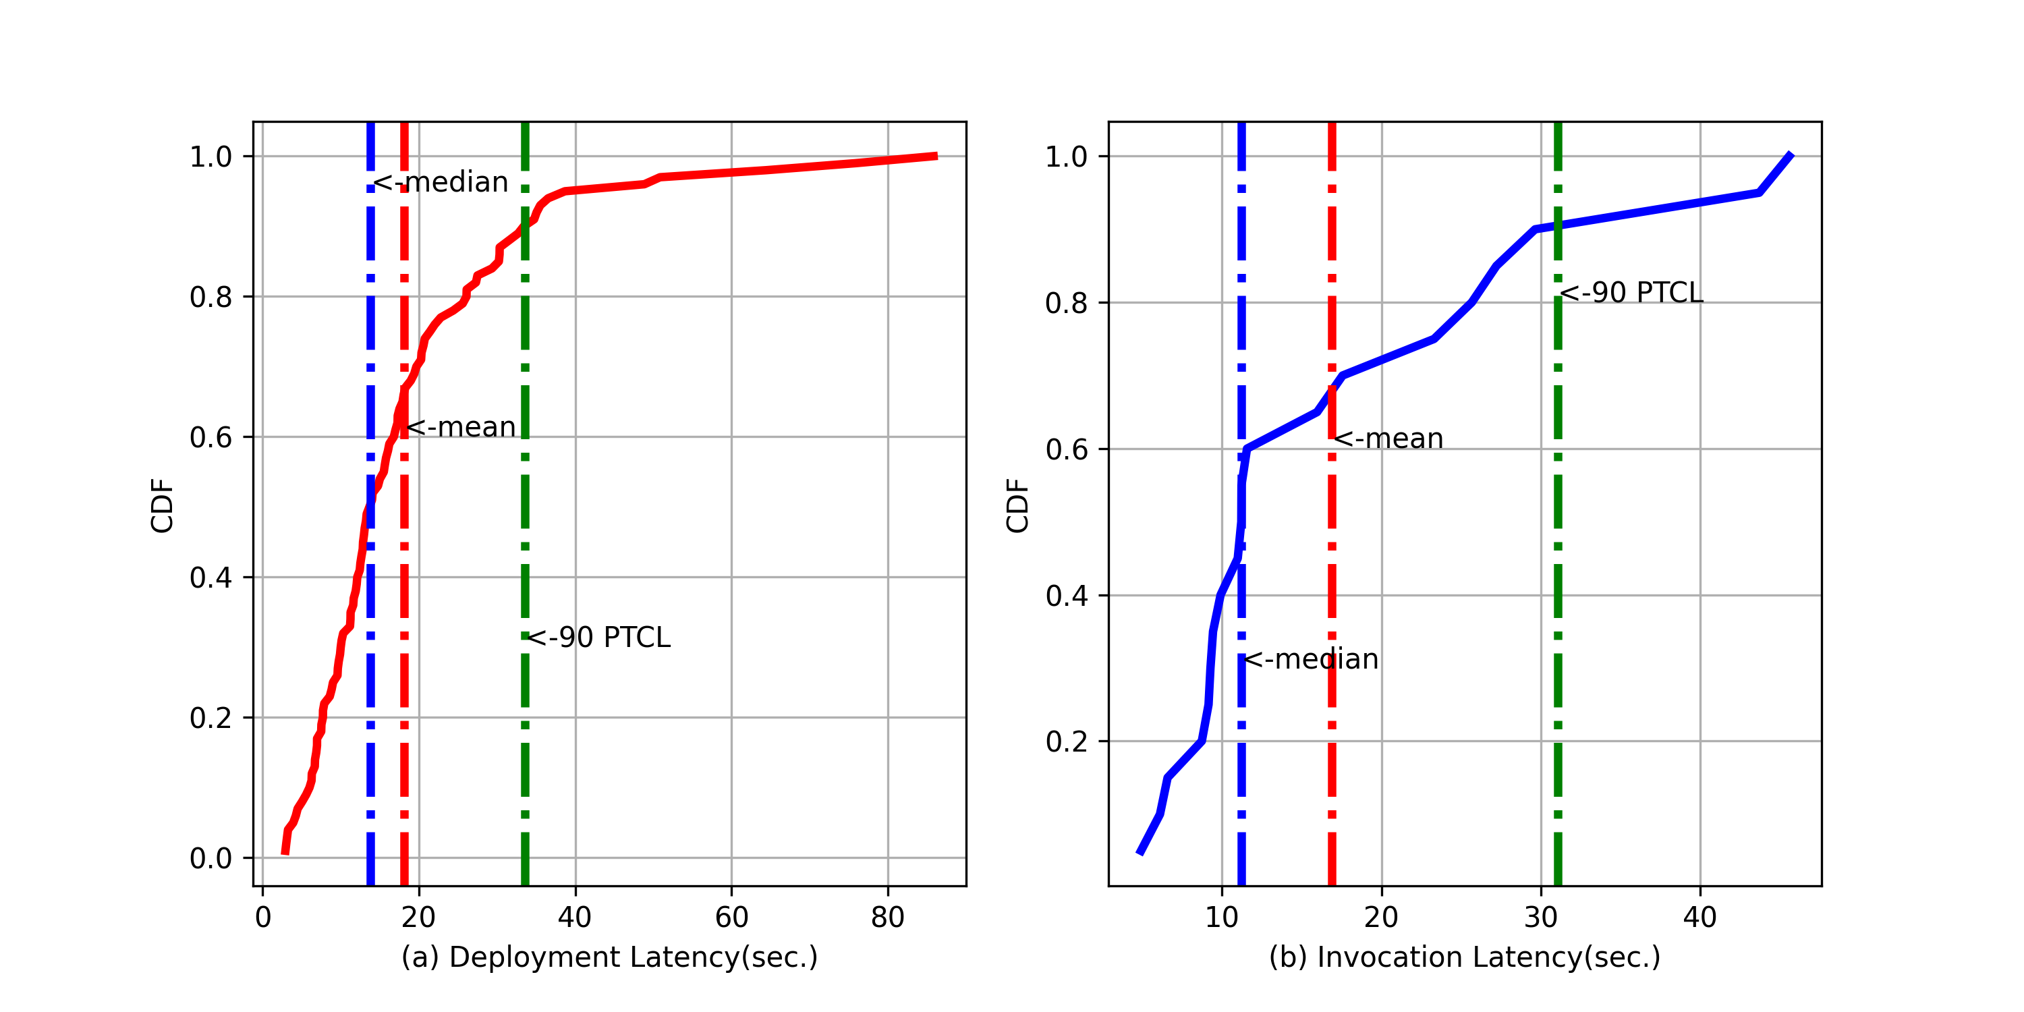
Can we adopt smart contracts for service contracts?
Mean Deployment ~18s.
Mean invocation ~16s.
Just-in-time contracts happen on the order of minutes
Resource reservation may take order of minutes.
https://dl.acm.org/doi/abs/10.1145/3411043.3412506
Notes:
Now the question is can smart contracts be adopted as service contracts or service level agreement. We already know that the smart contracts are software codes and they take time to deploy and execute, so we installed around 2000 contracts on the Ethereum Ropsten testnet, and measured the deployment and exeuction time. In this analysis it took around 18 s to deploy a contract 16 sec to invoke it.

Slide 13
ISG – PDL - Smart Contract Standardisation
Notes:
On this note, lets discuss the work we have done in ISG PDL, for the standardization of smart contracts in our WI PDL-004

Slide 14
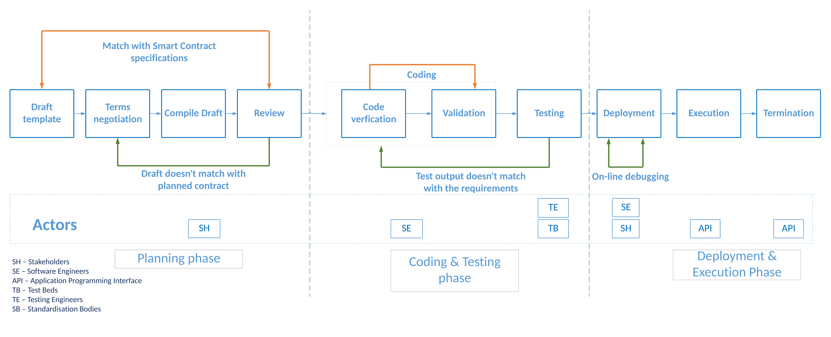
Smart contract life-cycle
Notes:
As it is mentioned earlier, that smart contracts are immutable, this means if there is any mistake in programming smart contract, it is recorded forever, so we discuss a smart contract life cycle in the group report. This life cycle has three main phases planning phase, coding and testing phase and deployment and execution phase. The idea is to check and verify smart contract at every step before the deployment. One important thing here is the last step of the termination – smart contracts can be on the ledger forever so it is important that they are destroyed after they fufil their purpose. And with this motivation we also outline two reference architectures for smart contracts.

Slide 15
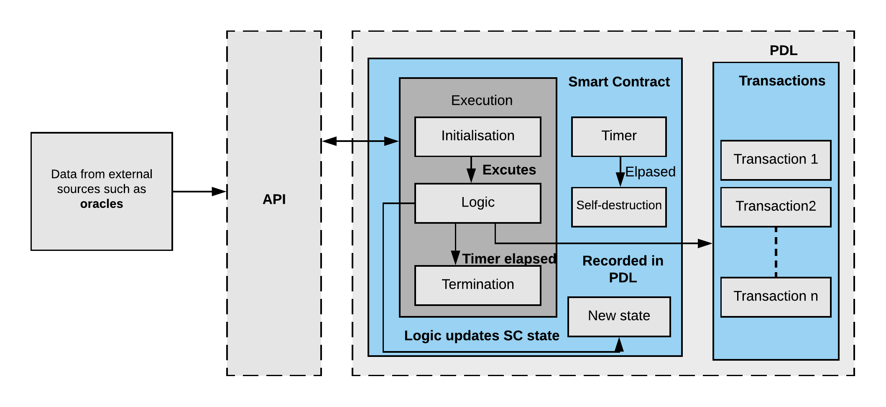
Smart Contract Reference Architecture
Notes:
1) In the first one - the data is input by external oracles through an API.

Slide 16
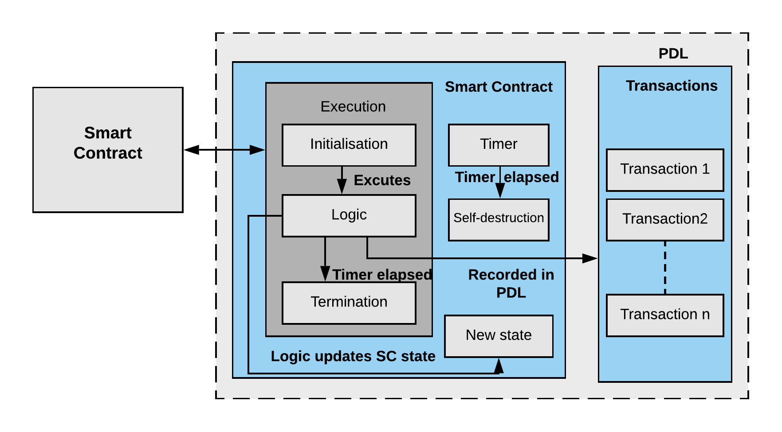
Smart Contract Reference Architecture (Contract Chaining)
Notes:
And in the second one another smart contract injects the data to the smart contract. Also node a timer in the contract which ensures that the contract is terminated after a certain time.

Slide 17
Conclusion
Notes:
So, with this architectures I would like to conclude today’s talk and

Slide 18
Conclusion
Smart contract standardisation is important because:
Future applications of IoT need flexibility, service level guarantee and accountability
Smart contracts are a potential solution for future accountable, transparent and autonomous contracting mechanism
They provide a method to create traceable audit mechanism

Slide 19
For Further Reference
ETSI ISG PDL
PDL Terms of Reference, ETSI ISG PDL Portal : https://portal.etsi.org/TB-SiteMap/PDL
Work Programme: https://portal.etsi.org/tb.aspx?tbid=873&SubTB=873#lt-50611-work-programme
PDL Community: https://portal.etsi.org/TB-SiteMap/PDL/List-of-PDL-Members-and-Participants
PDL Proofs of Concept (PoCs)
PDL Wiki and PoC Proposal How-To: https://pdlwiki.etsi.org/
Research and Standardisation
Research Projects interested in collaborating with PDL refer to: PDL Work Programme, PDL Membership List, PDL Member Agreement/PDL Participant Agreement
ETSI Research and Standards Website, ETSI Research Strategy, ETSI Tools for Researchers, FAQs on Research and Innovation: https://www.etsi.org/research
Notes:
And our last slide – with some links about our ISG.

